Slide 1
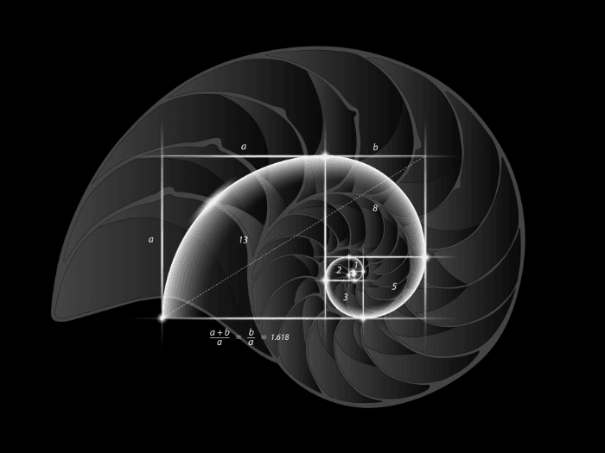
DESIGN
Patterns

Slide 2
In Nature, copied by artists
Fibonacci Sequence,
  X_{n} = X_{n-1} + X_{n-2}
  _{0,1,1,2,3,4,8,13,21,34}
  two successive Fibonacci numbers have a ratio very close to the Golden Ratio, which is roughly 1.618034
The Golden Ration

Slide 3
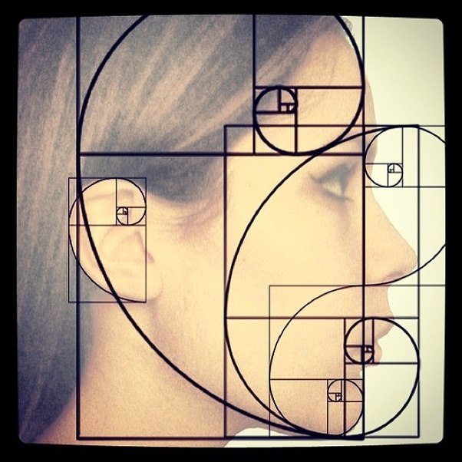

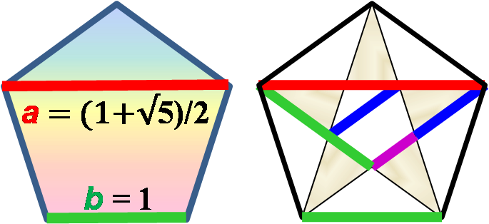
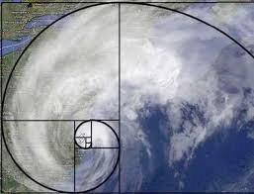
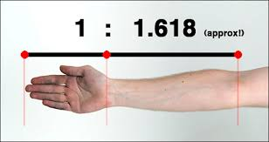

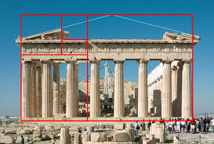


Slide 4
DNA
Genes are encoded with four base pairs.
These are copied to mRNA and sent to the Ribosomes
The Ribosomes manufactures proteins from 20 amino acids such as haemoglobin by reading 3 letters from the RNAm base pair.
DNA is not just a blue print it is adaptive. Genes get switched on or off depending on the environment factors (Epigenetics) - This is an important point, a design should be a blueprint which can be adapted

Slide 5
Design Patterns
Reusable general solutions to commonly occurring problems in software development.
They are only templates for how to solve a problem. Can be adapted to a given situation.
Patterns describe best practice, by implementing the pattern the developer is ‘hopefully’ following the best practice.
Descriptions of communicating objects and classes that are customized to solve a general design problem in a particular context

Slide 6
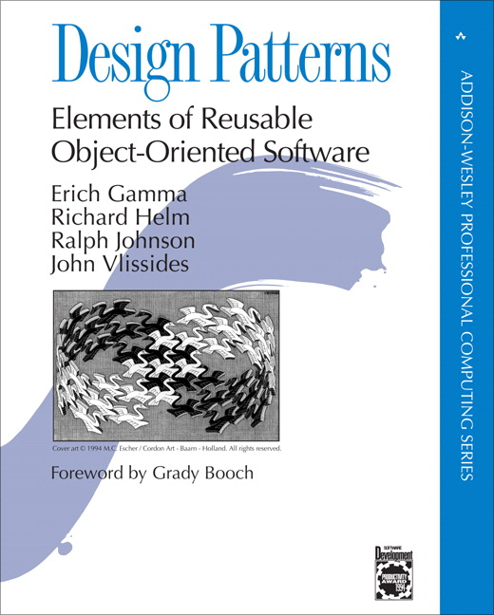
The “gang of four” (GoF)
  Design Patterns book contains 28 design patterns
  Book still important however it is a little out of date, there are many books on patterns which are more up to date
  Solutions to different classes of problems, in C++ & Smalltalk
  Problems and solutions are broadly applicable, developed over many years by the developer community.
  Patterns suggest opportunities for reuse in analysis, design and programming
  GOF presents each pattern in a structured format

Slide 7
Three Types of GoF Patterns
Creational patterns:
  Deal with initializing and configuring objects
Structural patterns:
  Composition of classes or objects
  Decouple interface and implementation of classes
Behavioral patterns:
  Deal with dynamic interactions among societies of objects
  How they distribute responsibility

Slide 8
Still evolving
Frameworks now encompass many elements of patterns
Code Complete, written by Steve McConnell and published in 1993 by Microsoft Press
Patterns of Enterprise Application Architecture, written by Matrin Fowler and published in 2002 by Addison Wesley.
Recommended text: Agile principles, patterns and practices. Robert C Martin

Slide 9
Creational Design Patterns
Source: http://en.wikipedia.org/wiki/Design_pattern_(computer_science)
Abstract factory | Provide an interface for creating families of related or dependent objects without specifying their concrete classes.
Builder | Separate the construction of a complex object from its representation allowing the same construction process to create various representations.
Factory method | Define an interface for creating an object, but let subclasses decide which class to instantiate. Factory Method lets a class defer instantiation to subclasses
Lazy initialization | Tactic of delaying the creation of an object, the calculation of a value, or some other expensive process until the first time it is needed. This pattern appears in the GoF catalog as "virtual proxy", an implementation strategy for the Proxy pattern.
Multiton | Ensure a class has only named instances, and provide global point of access to them.
Object pool | Avoid expensive acquisition and release of resources by recycling objects that are no longer in use. Can be considered a generalisation of connection pool and thread pool patterns.
Prototype | Specify the kinds of objects to create using a prototypical instance, and create new objects by copying this prototype.
Resource acquisition is initialization | Ensure that resources are properly released by tying them to the lifespan of suitable objects.
Singleton | Ensure a class has only one instance, and provide a global point of access to it.

Slide 10
Structural Design Patterns
Adapter or Wrapper or Translator. | Convert the interface of a class into another interface clients expect. An adapter lets classes work together that could not otherwise because of incompatible interfaces. The enterprise integration pattern equivalent is the translator.
Bridge | Decouple an abstraction from its implementation allowing the two to vary independently.
Composite | Compose objects into tree structures to represent part-whole hierarchies. Composite lets clients treat individual objects and compositions of objects uniformly.
Decorator | Attach additional responsibilities to an object dynamically keeping the same interface. Decorators provide a flexible alternative to subclassing for extending functionality.
Facade | Provide a unified interface to a set of interfaces in a subsystem. Facade defines a higher-level interface that makes the subsystem easier to use.
Flyweight | Use sharing to support large numbers of similar objects efficiently.
Front Controller | The pattern relates to the design of Web applications. It provides a centralized entry point for handling requests.
Module | Group several related elements, such as classes, singletons, methods, globally used, into a single conceptual entity.
Proxy | Provide a surrogate or placeholder for another object to control access to it.

Slide 11
Behavioural Design Patterns
Blackboard | Generalized observer, which allows multiple readers and writers. Communicates information system-wide.
Chain of responsibility | Avoid coupling the sender of a request to its receiver by giving more than one object a chance to handle the request. Chain the receiving objects and pass the request along the chain until an object handles it.
Command | Encapsulate a request as an object, thereby letting you parameterize clients with different requests, queue or log requests, and support undoable operations.
Interpreter | Given a language, define a representation for its grammar along with an interpreter that uses the representation to interpret sentences in the language.
Iterator | Provide a way to access the elements of an aggregate object sequentially without exposing its underlying representation.
Mediator | Define an object that encapsulates how a set of objects interact. Mediator promotes loose coupling by keeping objects from referring to each other explicitly, and it lets you vary their interaction independently.
Memento | Without violating encapsulation, capture and externalize an object's internal state allowing the object to be restored to this state later.
Null object | Avoid null references by providing a default object.

Slide 12
Behavioural Design Patterns
Observer or Publish/subscribe | Define a one-to-many dependency between objects where a state change in one object results in all its dependents being notified and updated automatically.
Servant | Define common functionality for a group of classes
Specification | Recombinable business logic in a Boolean fashion
State | Allow an object to alter its behavior when its internal state changes. The object will appear to change its class.
Strategy | Define a family of algorithms, encapsulate each one, and make them interchangeable. Strategy lets the algorithm vary independently from clients that use it.
Template method | Define the skeleton of an algorithm in an operation, deferring some steps to subclasses. Template method lets subclasses redefine certain steps of an algorithm without changing the algorithm's structure.
Visitor | Represent an operation to be performed on the elements of an object structure. Visitor lets you define a new operation without changing the classes of the elements on which it operates.

Slide 13
Creational Design Pattern factory
Widely used design pattern
Intent
  Creates objects without exposing the instantiation process for the client.
  Uses a common interface to refer to the newly created object.
Client does not directly create an object using the new operator, but instead asks the factory to create the new object.
Client provides information about the type of object it needs to the factory

Slide 14
Creational Design Pattern factory
uses
ask for new object
Client
<<interface>>
Product
Factory
+createProduct():product
Concrete Product
creates
The factory creates an new concrete object, and passes it back to the client as an abstract type
The client uses the object without needing to be aware of the actual concrete type

Slide 15
Creational Design Pattern factory
Scenario: Lodging Inquiry System. Customer needs to find out about the different types of rooms available.
Three different rooms
  BasicRoom
  NonACRoom
  ACRoom
Source : http://www.codeproject.com/Articles/37547/Exploring-Factory-Pattern

Slide 16
Creational Design Pattern factory
Firstly we need an interface IRoomType which defines the common behaviour of all rooms.
<<interface>>
IRoomType
+ GetDetails(): void
ACRoom
NonACRoom
BasicRoom

Slide 17
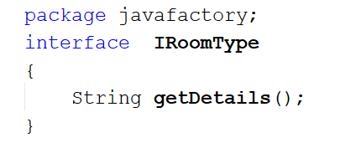
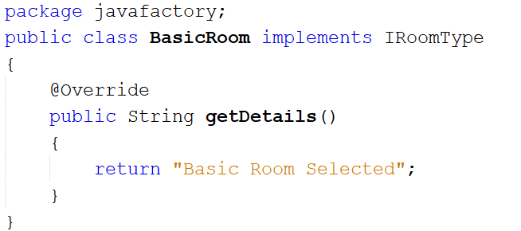
Room Type interface and single concrete class

Slide 18
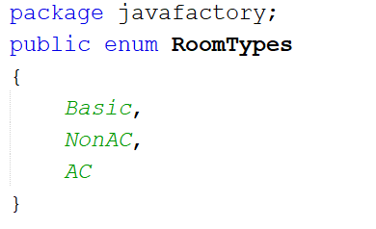
Creational Design Pattern factory - parameterised
Parameterised factory method
Since we are using a parameter it is cleaner with an enumeration

Slide 19
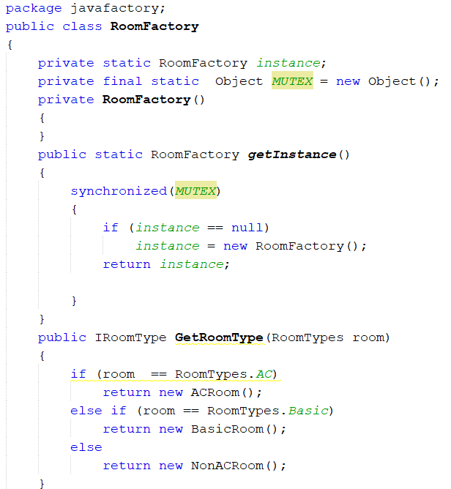
Creational Design Pattern factory - parameterised
Code for Singleton
Only one factory instance
Based on parameter the
appropriate object is
created and returned

Slide 20
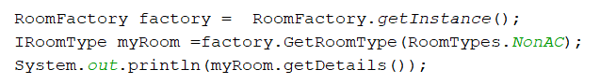
Creational Design Pattern factory - parameterised
Client code for calling the factory
Advantages
Easy to implement
Removes tight coupling between client and product classes.
Problems with parameterised factory
Adding a new type of room would require changes to Factory (violates open/closed principle)
Tight coupling between Factory and product classes

Slide 21
Creational Design Pattern factory – Self Registration
To simplify the solution by mitigating the need to use java reflections. A modification to the interface IRoomType is required.
An additional method CreateRoom is needed to force each room class to implement the new method. This new method returns a new instance of it’s own type. So a NonACRoom would return an new instance of NonACRoom.

Slide 22
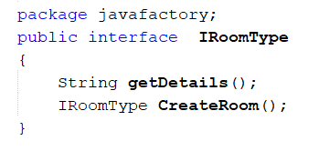
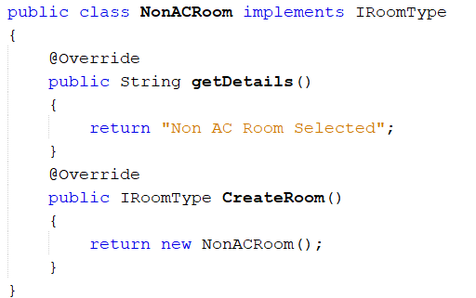
Creational Design Pattern factory – Self Registration

Slide 23
Creational Design Pattern
factory – Self Registration
Factory uses a hash to store the registered products.
All that the hash gives us it a way to look something up knowing a key value.
The enumeration of the room type will be the key value, and the associated stored value is the type of concrete class that needs to be created when given the key.

Slide 24
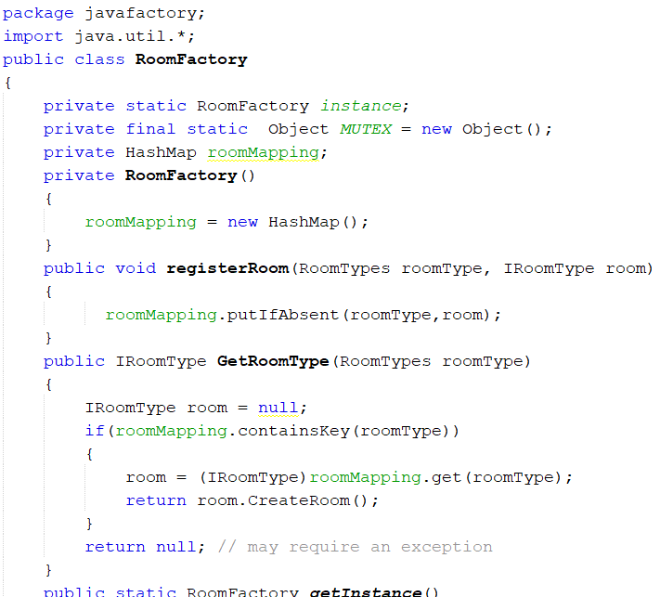
Creational Design Pattern
factory – Self Registration

Slide 25
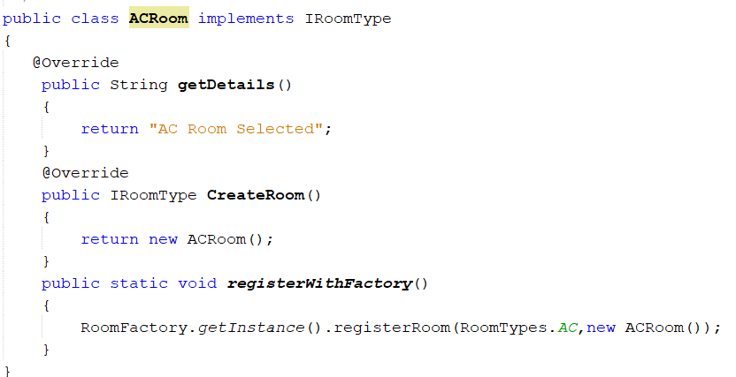
Creational Design Pattern
factory – Self Registration
Each room needs to be able to register it’s self with the factory.
It passes the Key (room type enumeration) and as instance of it’s self to the Factory for registration

Slide 26
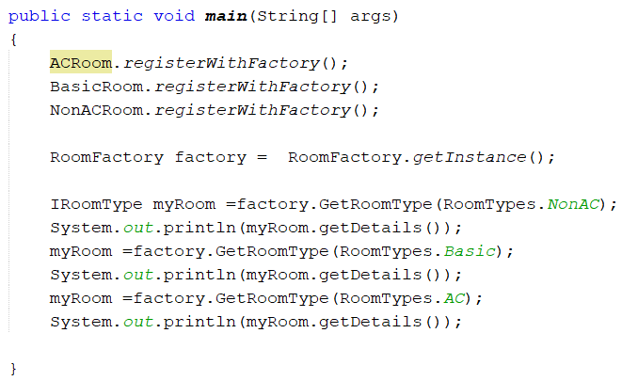
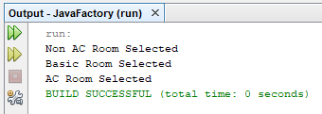
Creational Design Pattern factory – Self Registration
We need to register the rooms before use and use the enumeration to with the factory to produce the correct type of room.

Slide 27
Creational Design Pattern factory – Self Registration
Advantages
  Adding new products does not require a change to the factory therefore open/closed principle not violated
  Loose coupling between factory and products
Disadvantages
  Client needs to register products with factory before use

